Slide 1
DeepPurple
Hackathon Data Challenge
PI: Vahid Tarokh
Yu Xiang, Jie Ding, Jiawen Zhou, Enmao Diao, Yuting Sun
School of Eng. & Applied Sciences (SEAS)
Harvard University

Slide 2
Duke data
Physiological sensor data + RNA-seq
Goal: Predict infection within 24 hours after the inoculation
Our approach:
Hypothesis testing based on the clusters of spectral distances and RNA-seq

Slide 3
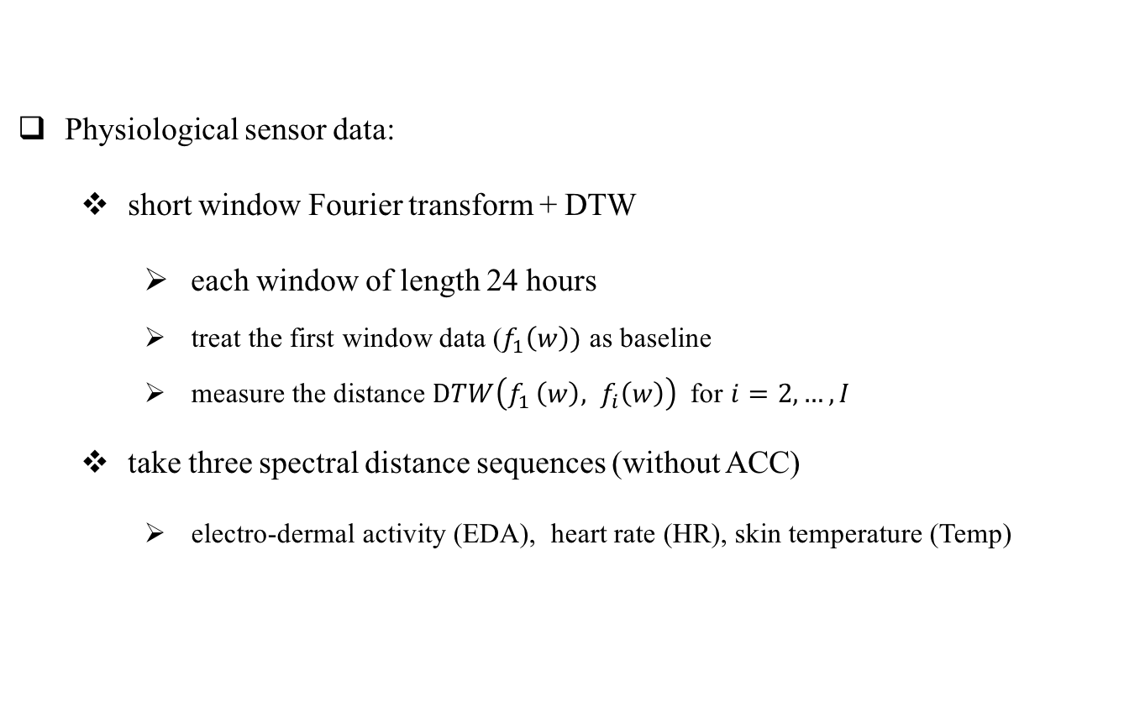
Duke data: Physiological Sensor Data
Physiological sensor data:
short window Fourier transform + DTW
each window of length 24 hours
treat the first window data ($f_{1}\left(w\right))$ as baseline
measure the distance $DTW\left(f_{1 }\left(w\right), f_{i}\left(w\right)\right)$ for $i=2,…, I$
take three spectral distance sequences (without ACC)
electro-dermal activity (EDA), heart rate (HR), skin temperature (Temp)

Slide 4
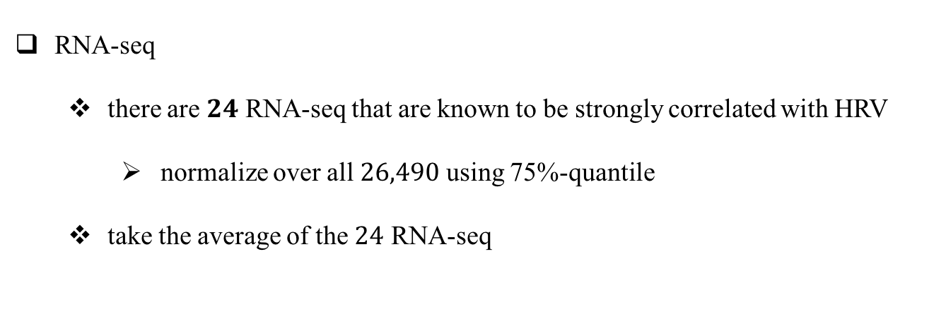
Duke data: RNA-seq
RNA-seq
there are $24$ RNA-seq that are known to be strongly correlated with HRV
normalize over all $26,490$ using 75%-quantile
take the average of the $24$ RNA-seq

Slide 5
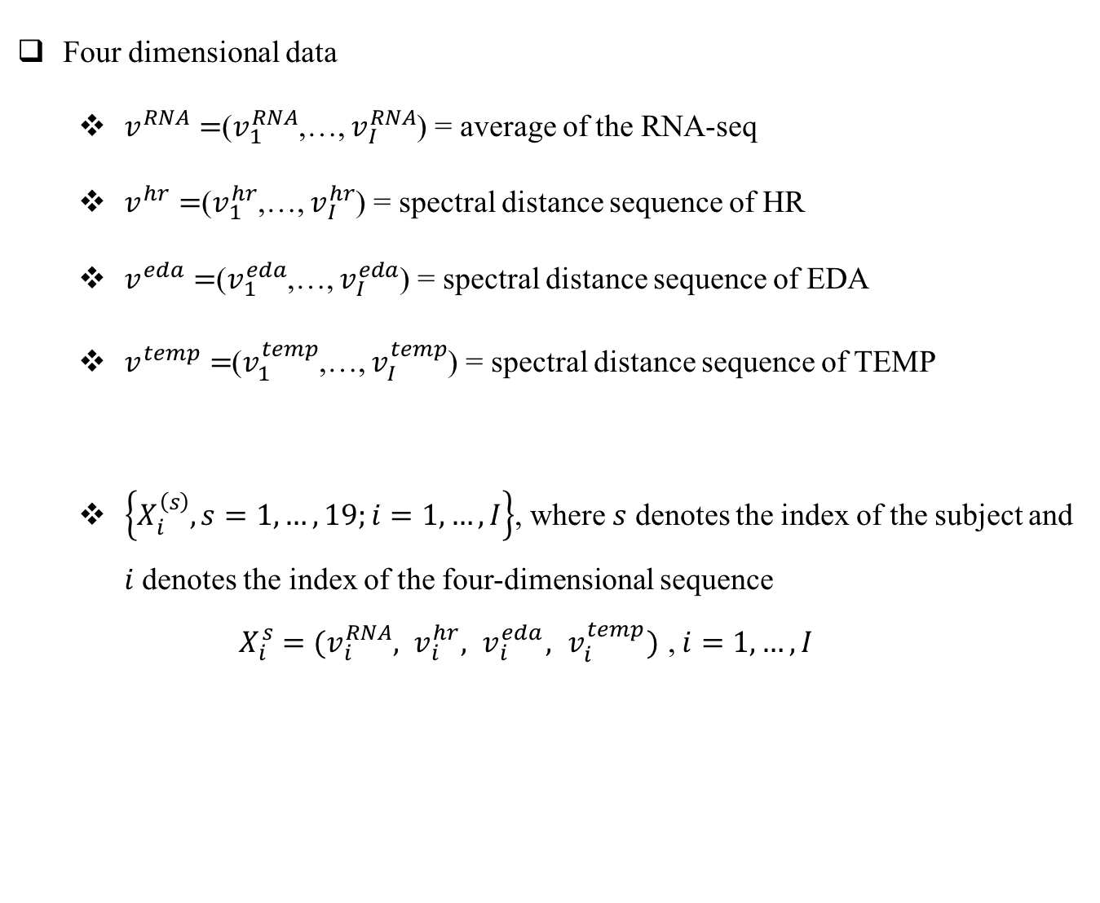
Summary Results
Four dimensional data
$v^{RNA}=$($v_{1}^{RNA}$,…, $v_{I}^{RNA}$) = average of the RNA-seq
$v^{hr}=$($v_{1}^{hr}$,…, $v_{I}^{hr}$) = spectral distance sequence of HR
$v^{eda}=$($v_{1}^{eda}$,…, $v_{I}^{eda}$) = spectral distance sequence of EDA
$v^{temp}=$($v_{1}^{temp}$,…, $v_{I}^{temp}$) = spectral distance sequence of TEMP
$\left\{X_{i}^{\left(s\right)}, s=1,…,19;i=1,…,I\right\}$, where $s$ denotes the index of the subject and $i$ denotes the index of the four-dimensional sequence
$X_{i}^{s}=(v_{i}^{RNA}, v_{i}^{hr},{ v}_{i}^{eda},{ v}_{i}^{temp})$ , $i=1,…,I$

Slide 6
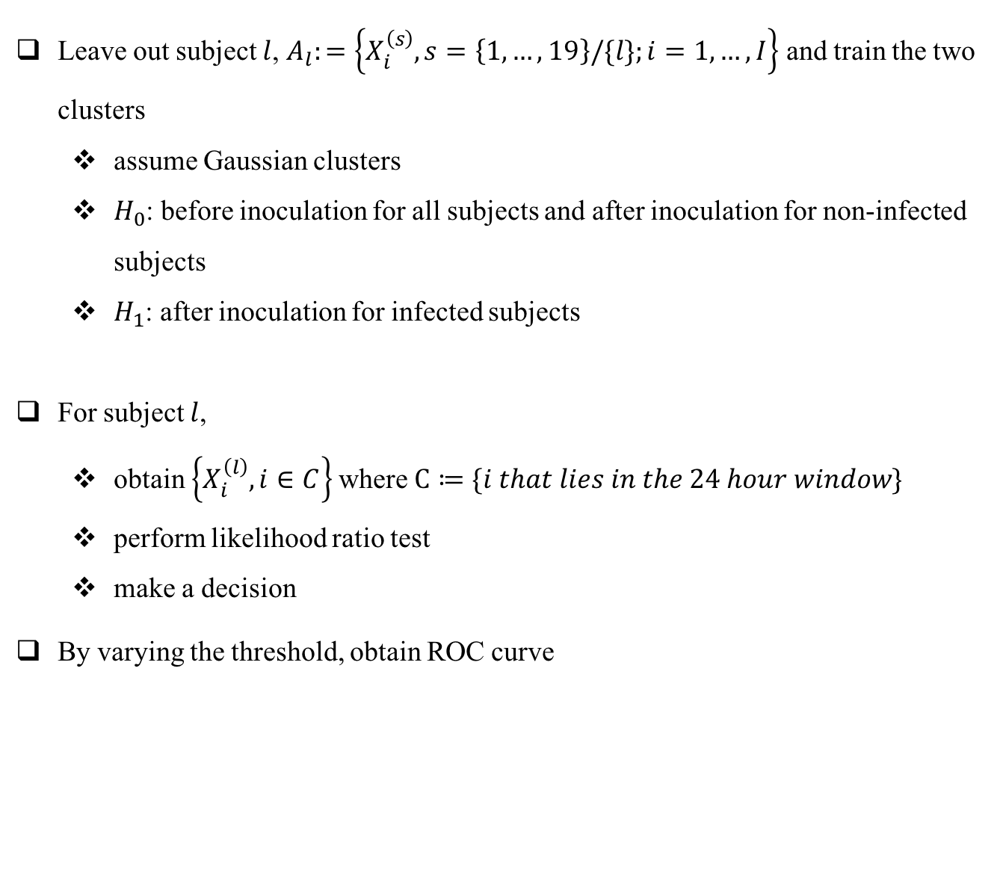
Summary Results
Leave out subject $l$, $A_{l}:=\left\{X_{i}^{\left(s\right)}, s=\left\{1,…,19\right\}/\{l\};i=1,…, I\right\}$ and train the two clusters
assume Gaussian clusters
$H_{0}$: before inoculation for all subjects and after inoculation for non-infected subjects
$H_{1}$: after inoculation for infected subjects
For subject $l$,
obtain $\left\{X_{i}^{\left(l\right)}, i∈C\right\}$ where $C≔\{i that lies in the 24 hour window\}$
perform likelihood ratio test
make a decision
By varying the threshold, obtain ROC curve

Slide 7

Summary Results
For $24$ hour window after inoculation

Slide 8
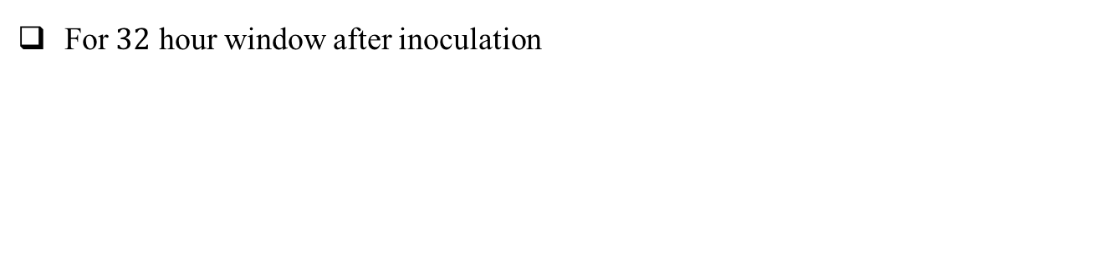
Summary Results
For $32$ hour window after inoculation

